Slide 1


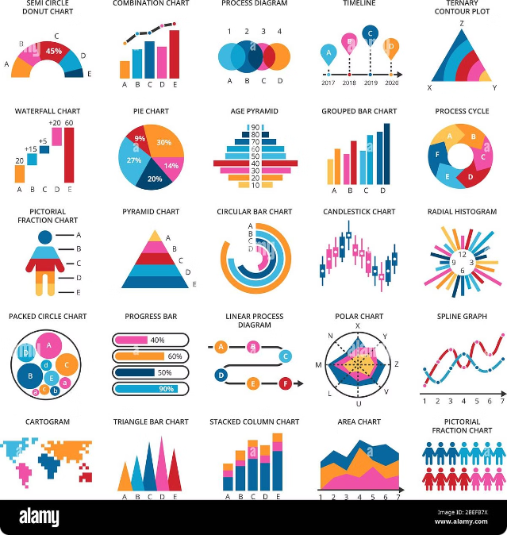
Unlocking Insights: Amazon Sales Data Analysis
This presentation outlines a comprehensive approach to analyzing Amazon sales data, uncovering key insights, and driving impactful business decisions.
by Trideep Saha

Slide 2


The Power of Data-Driven Sales Management
In today's competitive marketplace, data-driven sales management is essential for optimizing performance, boosting profits, and gaining a competitive edge.
Understanding Customer Needs
Analyzing purchase patterns, reviews, and search queries reveals valuable insights into customer preferences and unmet needs.
Optimizing Product Strategies
Data can help identify best-selling products, product trends, and potential opportunities for new product development.
Improving Operational Efficiency
Data analysis can help businesses streamline operations, optimize inventory management, and reduce costs.
Personalized Marketing Campaigns
Understanding customer demographics, purchase history, and browsing behavior allows for targeted and effective marketing efforts.

Slide 3


Exploring the Data Landscape
Exploratory Data Analysis (EDA) provides a structured approach to examining raw data, identifying patterns, and uncovering hidden relationships.
1
Data Cleaning and Preparation
Ensure data quality by removing inconsistencies, handling missing values, and transforming data into a usable format.
2
Descriptive Statistics
Calculate key metrics like average sales, revenue, product popularity, and customer demographics.
3
Visualizations
Create informative charts and graphs to represent data visually and identify trends, outliers, and relationships.
4
Hypothesis Testing
Test specific assumptions about the data to validate insights and draw statistically sound conclusions.

Slide 4






Transforming Insights into Action
The insights derived from sales data analysis serve as a foundation for informed decision-making, driving business growth and profitability.
Identify Key Opportunities
Leverage data insights to identify growth opportunities in new markets, product categories, or customer segments.
Optimize Marketing Strategies
Tailor marketing campaigns to specific customer segments, channels, and touchpoints based on data-driven insights.
Improve Product Development
Use data to inform product development decisions, focusing on popular products, evolving trends, and customer needs.
Enhance Operational Efficiency
Streamline operations, improve inventory management, and reduce costs based on data-driven insights into supply chain performance.

Slide 5
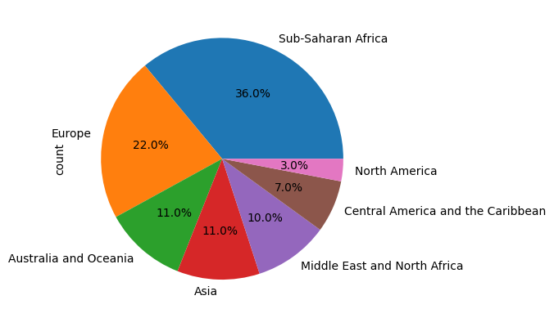
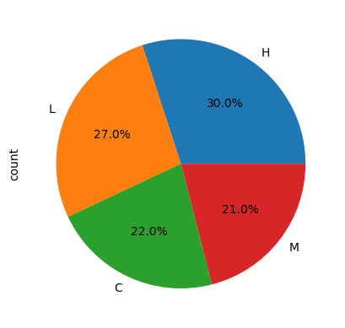
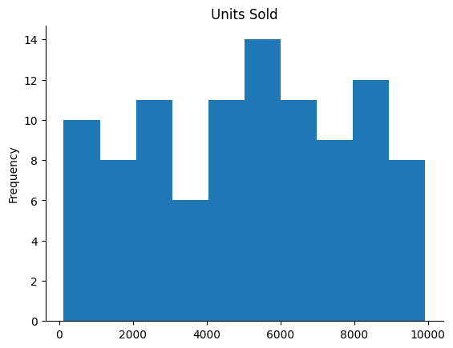
Output Dashboard
Predictive modeling and forecasting techniques leverage historical data to predict future sales trends, enabling proactive decision-making.
Distribution of Sales by Region
Order Priority
Units sold

Slide 6
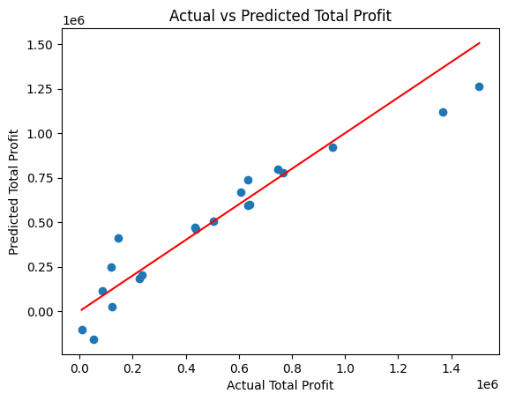
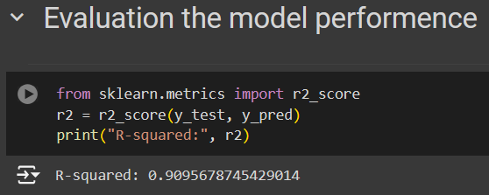
Predicting total profit using Linear Regression Model

